Slide 1
User Guide for SFT Tracker
For all users

Slide 2
Introduction
SFT Tracker is a web application for 30SCE soldiers to conveniently log their participation in Self-Regulated Fitness Training. This application is linked to a Google Sheet where commanders can monitor the status of the soldiers under their command.
Quick Start
Click here to access the application on your phone’s browser.
You need internet access to be able to use the application.

Slide 3

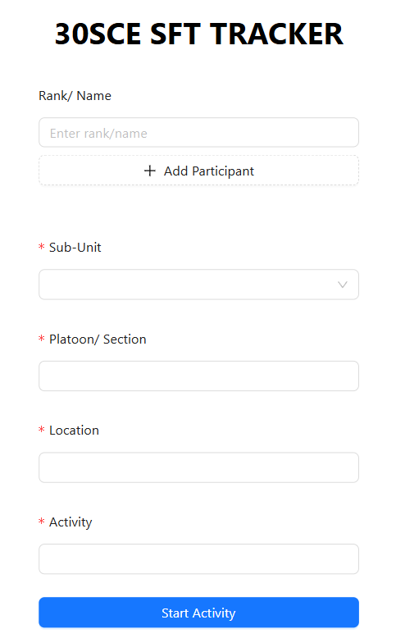
Logging your SFT using the application
1. Enter your rank and name here
2. Click here to add in another participant.
SFT must be done in buddy level. You will not be able to start your activity if you don’t have a buddy.
3. Use the drop down menu to select your sub-unit.
4. For ‘A’ Coy, ‘B’ Coy, ‘C’ Coy and ‘ME’ Coy soldiers, key in your platoon and section in the following format “<platoon>/ section>”.
For “HQ” Coy, enter your Branch/ Department
5. Enter the location of your activity here.
7. Click here to start your activity.
6. Enter the name of your activity here.

Slide 4
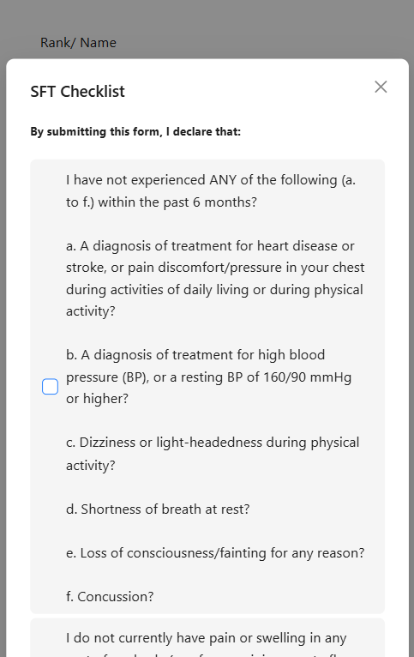
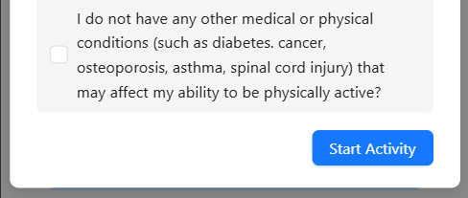
Logging your SFT using the application
7. Read through the checklist carefully and select the options that apply. You will not be able to start the activity if you do not fulfil all the pre-requisites listed in the checklist.
8. Click this button to start the activity.

Slide 5
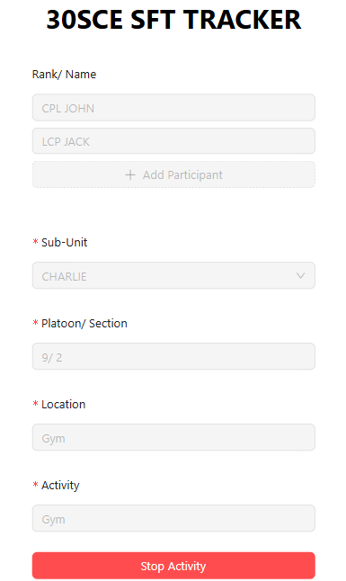
Logging your SFT using the application
9. After you are done with your workout, click this button to end the activity.

Slide 6
User Guide for Checking the SFT Record
For Commanders

Slide 7
Google Sheet
All activities will be logged in Google Sheets. Only selected commanders (S3 Dept, OCs, CSMs) will be able to edit the logs. All commanders will be able to view the logs here.

Slide 8
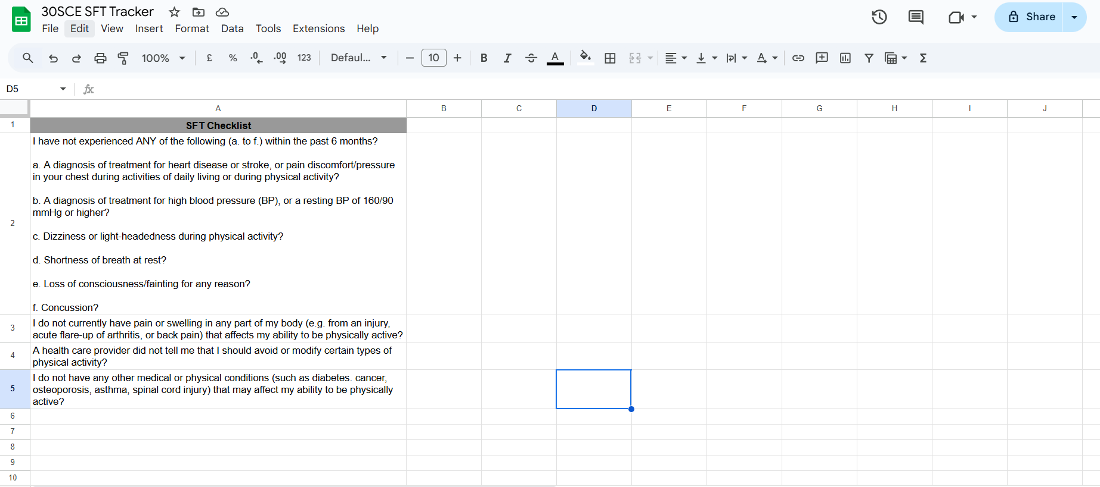
Configuring the SFT Checklist (Only for Designated Commanders)
To edit the SFT checklist, simply edit cells in Column A.
To add/ delete questions in the checklist, add/ delete a new row in Column A.

Slide 9
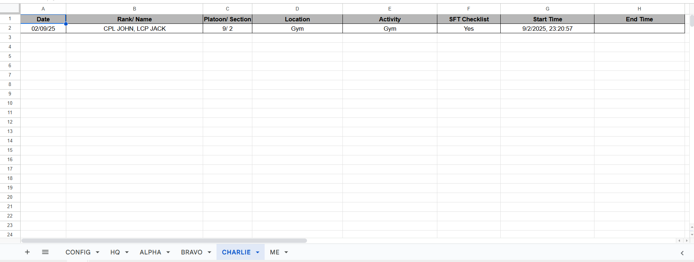
Viewing the SFT Logs (For all commanders)
2. The logs will be displayed here.
3. If there is no “End Time” this means that the SFT is still in progress.
1. Select the Sub-Unit you are from.
4. Once the SFT has finished, the “End Time” will be reflected here.

Slide 10
Timeline for Implementation
09/25 CO Conference
State implementing for ‘A’ Coy and ‘HQ’ Coy
10/25 CO Conference
State implementing for the rest of the Battalion and start handing over the project to S3 Br
11/25 CO Conference
Project fully handed over to S3 Br

